Slide 1


Welcome to Cybage
This document and all its contents contain information from Cybage Software Private Limited which may be privileged, confidential, or otherwise protected from disclosure. The information is intended to be for the addressee(s) only. Any unauthorized disclosure, copy, distribution, or use of the contents of this message is strictly prohibited.

Slide 2
CybageNet-Book Review System

Slide 3
CybageNet-Book Review System
Group 7-Team Members
16110 Lokesh Nehete
16170 Geetanjali Kulkarni
16083 Abhinav Anand
16 Hemant Bhosale
16206 Subhashini Asthana
16210 Umesh Kumar Toke

Slide 4
CybageNet—Book Review System
Followed Model2 (MVC) Approach
UI Designed by using Bootstrap for user responsiveness
Jsp pages moved to WEB-INF/views folder for security purpose
DAO design Pattern
Accepting the database properties from resource.properites file (Loose Coupling)
Singleton Design Pattern for Database

Slide 5
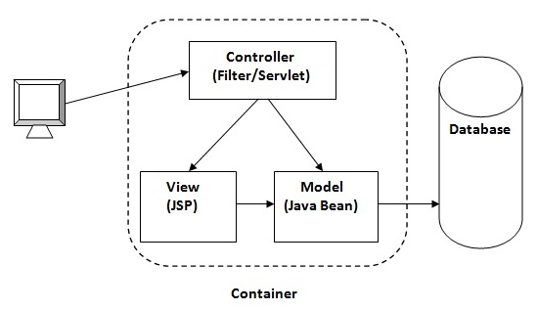
CybageNet—Book Review System
Model2 (MVC) Architecture

Slide 6
CybageNet (Database Schema explained by geetanjali)

Slide 7
CybageNet (Login Module explained by Umesh Toke)

Slide 8
CybageNet (Active Users explained by Subhashini Asthana)

Slide 9
CybageNet (Add Books explained by Lokesh Nehete)

Slide 10
CybageNet (Delete Books explained by Hemant Bhosale)

Slide 11
CybageNet (Search Books with Reviews explained by Abhinav Anand)

Slide 12
CybageNet (LogOut explained by Umesh Kumar Toke)

Slide 13
Thank You!

